Slide 1
Gaussian-process-augmented projection-based model order reduction
Carlos González Hernández, Radek Tezaur, Charbel Farhat
APS DFD 2024
Stanford University

Slide 2
Motivation
Many important engineering applications rely on many queries of high-dimensional computational models
Model predictive control
Uncertainty quantification
Design analysis & optimization
Surrogate models are often required for these to be computationally tractable
Seek a more parsimonious description of the high-dimensional model through dimensionality reduction
Dimensionality reduction approaches
External representations: linear regression, gaussian process regression, artificial neural network regression
Internal representations: operator-inference model, physics-informed neural networks, projection-based reduced-order models

Slide 3
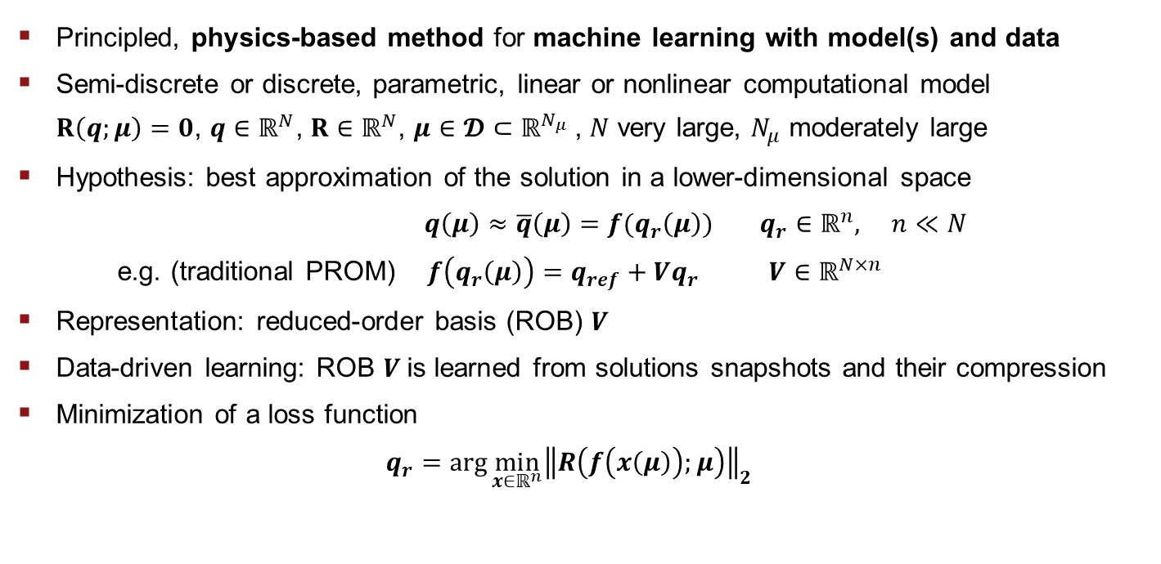
Projection-based model order reduction (PMOR)
Principled, physics-based method for machine learning with model(s) and data
Semi-discrete or discrete, parametric, linear or nonlinear computational model
$R\left(q;μ\right)=0$, $q∈ℝ^{N}$, $R∈ℝ^{N}$, ${μ∈{𝓓⊂ℝ}^{N_{μ}}}_{ }$, $N$ very large, $N_{μ}$ moderately large
Hypothesis: best approximation of the solution in a lower-dimensional space
$q\left(μ\right)≈\overline{q}\left(μ\right)=f(q_{r}\left(μ\right))$ $q_{r}∈ℝ^{n},$ $n≪N$
e.g. (traditional PROM) $f\left(q_{r}\left(μ\right)\right)=q_{ref}+Vq_{r}$ ${V∈ℝ^{N×n}}_{ }$
Representation: reduced-order basis (ROB) $V$
Data-driven learning: ROB $V$is learned from solutions snapshots and their compression
Minimization of a loss function
$q_{r}=arg\min_{x∈ℝ^{n}}{{\left\|R\left(f\left(x\left(μ\right)\right);μ\right)\right\|}_{2}}$

Slide 4
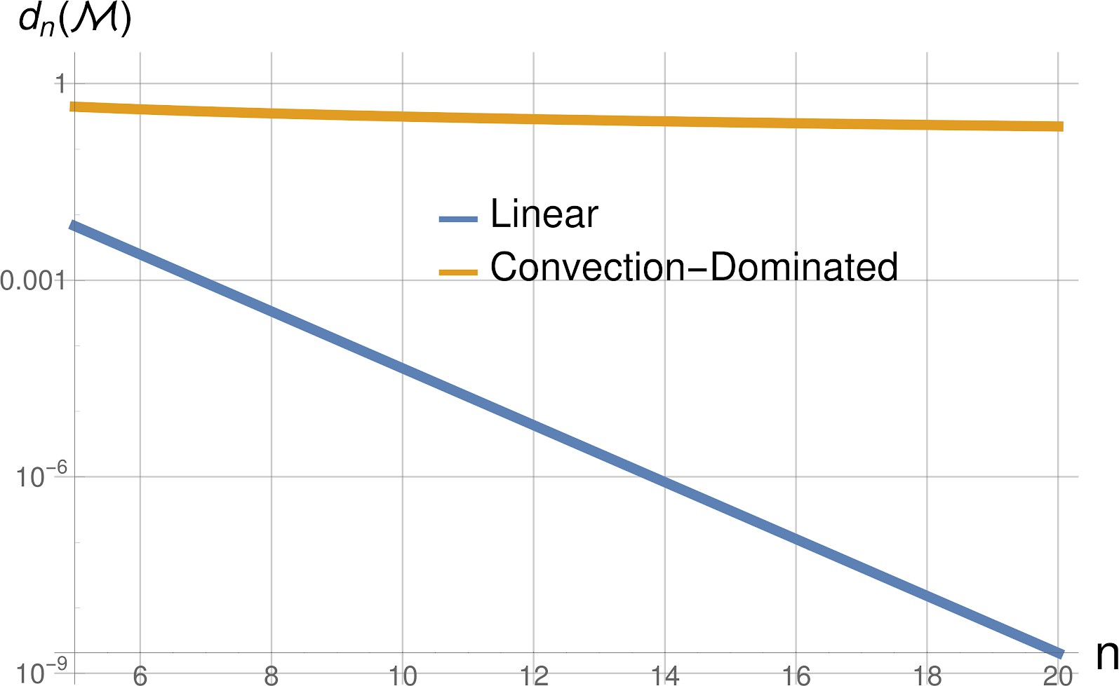
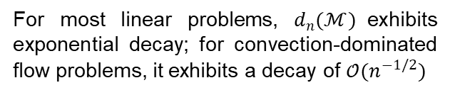
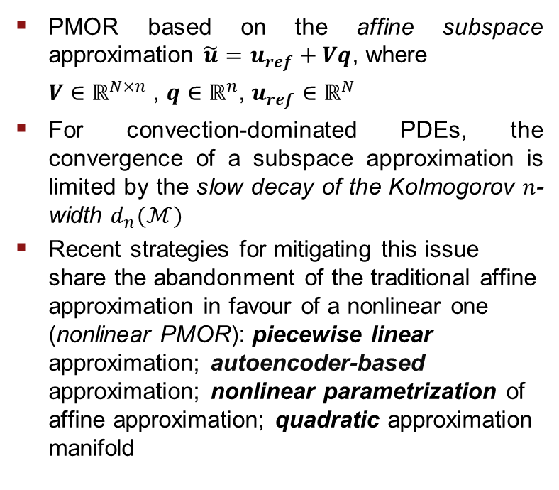
Challenge in PMOR – breaking the Kolmogorov n-width
PMOR based on the affine subspace approximation $\tilde{u}=u_{ref}+Vq$, where
${V∈ℝ^{N×n}}_{ }$, $q∈ℝ^{n}$, $u_{ref}∈ℝ^{N}$
For convection-dominated PDEs, the convergence of a subspace approximation is limited by the slow decay of the Kolmogorov $n$-width $d_{n}(ℳ)$
Recent strategies for mitigating this issue share the abandonment of the traditional affine approximation in favour of a nonlinear one (nonlinear PMOR): piecewise linear approximation; autoencoder-based approximation; nonlinear parametrization of affine approximation; quadratic approximation manifold
For most linear problems, $d_{n}(ℳ)$exhibits exponential decay; for convection-dominated flow problems, it exhibits a decay of ${𝒪(n^{−1/2})}_{ }$

Slide 5
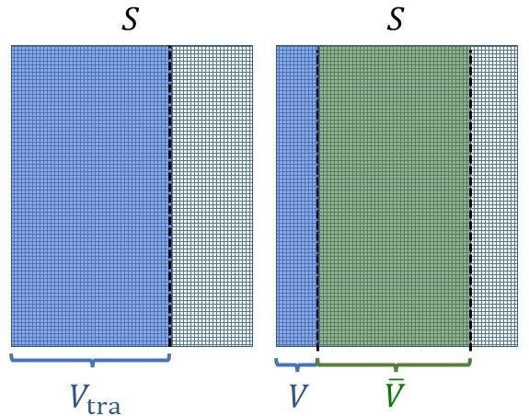
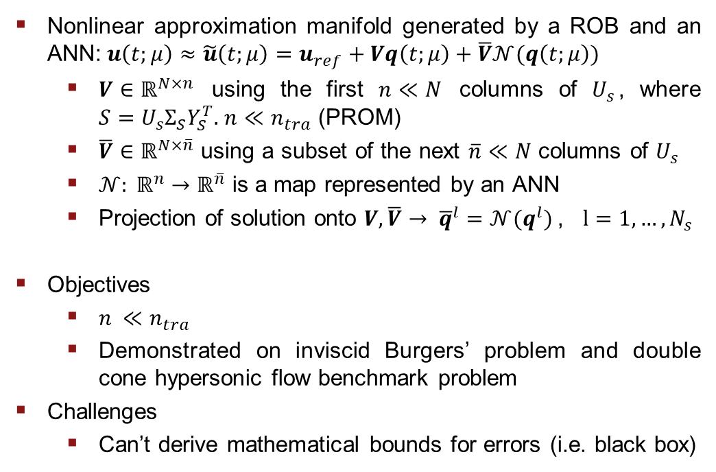
Arbitrarily nonlinear approx. for mitigating Kolmogorov barrier
Nonlinear approximation manifold generated by a ROB and an ANN:$u\left(t;μ\right)≈\tilde{u}\left(t;μ\right)=u_{ref}+Vq\left(t;μ\right)+\overline{V}𝒩(q\left(t;μ\right))$
$V∈ℝ^{N×n}$ using the first $n≪N$ columns of $U_{s}$, where ${S=U}_{s}Σ_{S}Y_{S}^{T}.$ $n≪n_{tra}$ (PROM)
$\overline{V}∈ℝ^{N×\overline{n}}$ using a subset of the next $\overline{n}≪N$ columns of $U_{s}$
${𝒩: ℝ}^{n}→ℝ^{\overline{n}}$ is a map represented by an ANN
Projection of solution onto $V,\overline{V}→ {\overline{q}}^{l}={𝒩(q^{l})}^{ }$, $l=1, …, N_{s}$
Objectives
$n_{ }≪n_{tra}$
Demonstrated on inviscid Burgers’ problem and double cone hypersonic flow benchmark problem
Challenges
Can’t derive mathematical bounds for errors (i.e. black box)
PROM-ANN (Barnett et al. 2023, JCP)
Construction of a ROB for: a traditional PROM (left); and a PROM-ANN (right)

Slide 6
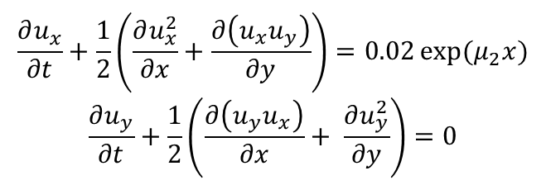
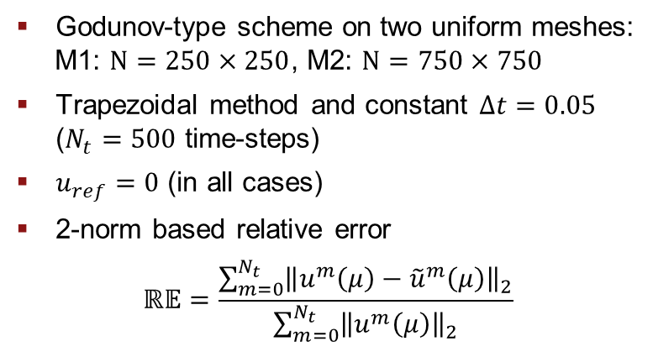
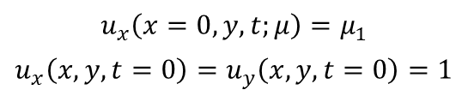
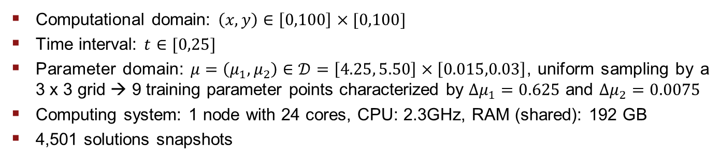
Application: Inviscid Burgers’ problem
$$\frac{∂u_{x}}{∂t}+\frac{1}{2}\left(\frac{∂u_{x}^{2}}{∂x}+\frac{∂\left(u_{x}u_{y}\right)}{∂y}\right)=0.02\exp{{(μ}_{2}x})$$
$$\frac{∂u_{y}}{∂t}+\frac{1}{2}\left(\frac{∂\left(u_{y}u_{x}\right)}{∂x}+ \frac{∂u_{y}^{2}}{∂y}\right)=0$$
Godunov-type scheme on two uniform meshes:
M1: $N=250×250$, M2: $N=750×750$
Trapezoidal method and constant $Δt=0.05$ ($N_{t}=500$ time-steps)
$u_{ref}=0$ (in all cases)
2-norm based relative error
$$ℝ𝔼=\frac{\sum_{m=0}^{N_{t}}{{\left\|u^{m}\left(μ\right)−{\tilde{u}}^{m}\left(μ\right)\right\|}_{2}}}{\sum_{m=0}^{N_{t}}{{\left\|u^{m}\left(μ\right)\right\|}_{2}}}$$
$$u_{x}\left(x=0,y,t;μ\right)=μ_{1}$$
$$u_{x}\left(x,y,t=0\right)=u_{y}\left(x,y,t=0\right)=1$$
Computational domain: $\left(x,y\right)∈\left[0,100\right]×[0,100]$
Time interval: $t∈[0,25]$
Parameter domain: $μ=\left(μ_{1}, μ_{2}\right)∈𝒟=\left[4.25, 5.50\right]×\left[0.015,0.03\right]$, uniform sampling by a 3 x 3 grid → 9 training parameter points characterized by $Δμ_{1}=0.625$ and $Δμ_{2}=0.0075$
Computing system: 1 node with 24 cores, CPU: 2.3GHz, RAM (shared): 192 GB
4,501 solutions snapshots

Slide 7
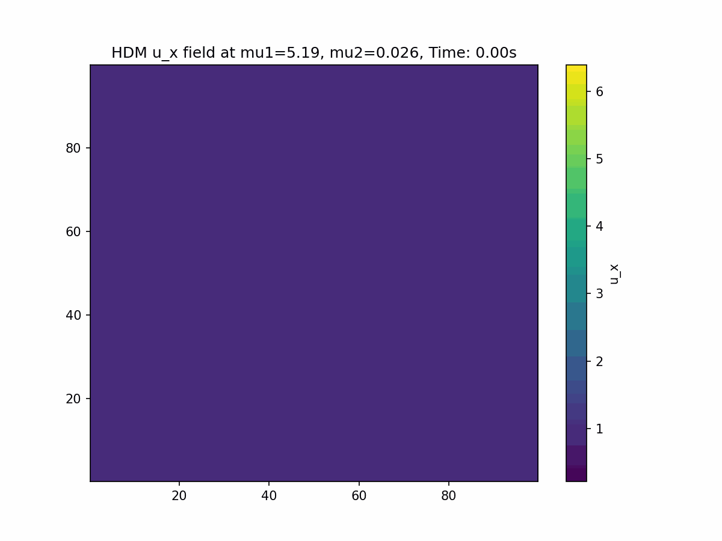
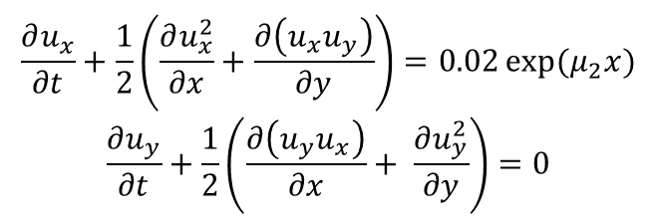
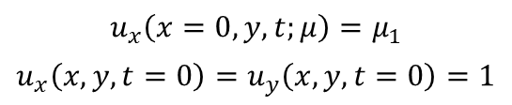
Application: Inviscid Burgers’ problem
$$\frac{∂u_{x}}{∂t}+\frac{1}{2}\left(\frac{∂u_{x}^{2}}{∂x}+\frac{∂\left(u_{x}u_{y}\right)}{∂y}\right)=0.02\exp{{(μ}_{2}x})$$
$$\frac{∂u_{y}}{∂t}+\frac{1}{2}\left(\frac{∂\left(u_{y}u_{x}\right)}{∂x}+ \frac{∂u_{y}^{2}}{∂y}\right)=0$$
$$u_{x}\left(x=0,y,t;μ\right)=μ_{1}$$
$$u_{x}\left(x,y,t=0\right)=u_{y}\left(x,y,t=0\right)=1$$

Slide 8
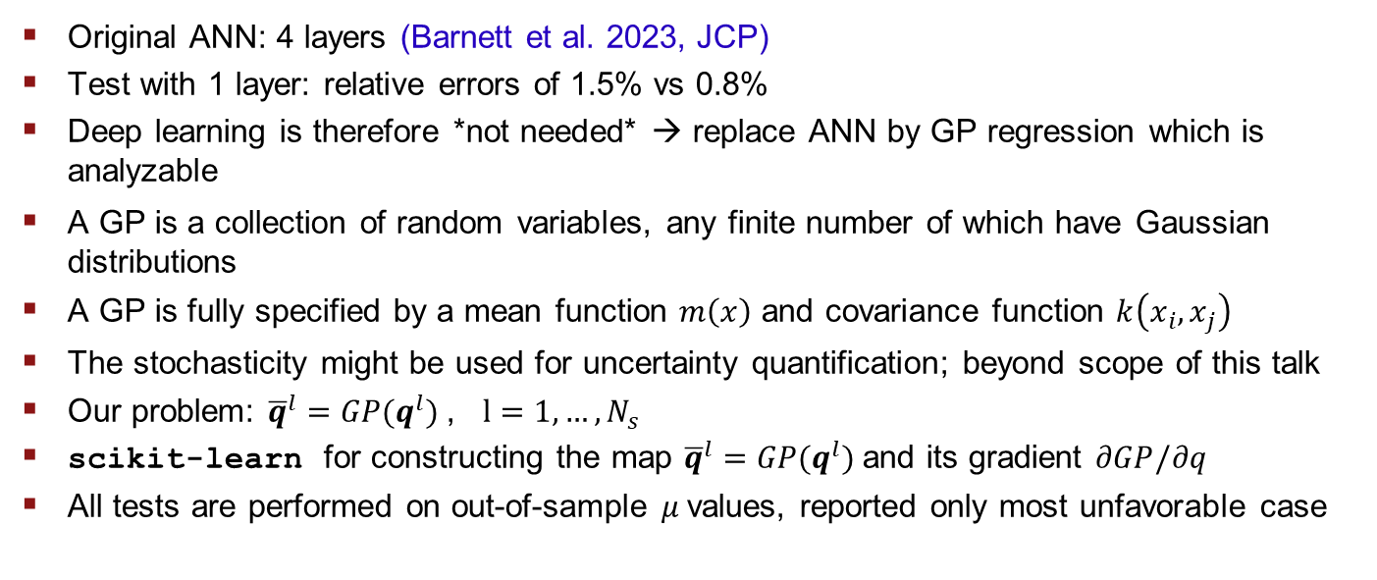
Alternative approach for building the map in the latent space: gaussian process
Original ANN: 4 layers (Barnett et al. 2023, JCP)
Test with 1 layer: relative errors of 1.5% vs 0.8%
Deep learning is therefore *not needed* → replace ANN by GP regression which is analyzable
A GP is a collection of random variables, any finite number of which have Gaussian distributions
A GP is fully specified by a mean function $m\left(x\right)$ and covariance function $k\left(x_{i},x_{j}\right)$
The stochasticity might be used for uncertainty quantification; beyond scope of this talk
Our problem: ${\overline{q}}^{l}={GP(q^{l})}^{ }$, $l=1, …, N_{s}$
scikit-learn for constructing the map ${\overline{q}}^{l}={GP(q^{l})}^{ }$and its gradient $∂GP/∂q$
All tests are performed on out-of-sample $μ$values, reported only most unfavorable case

Slide 9
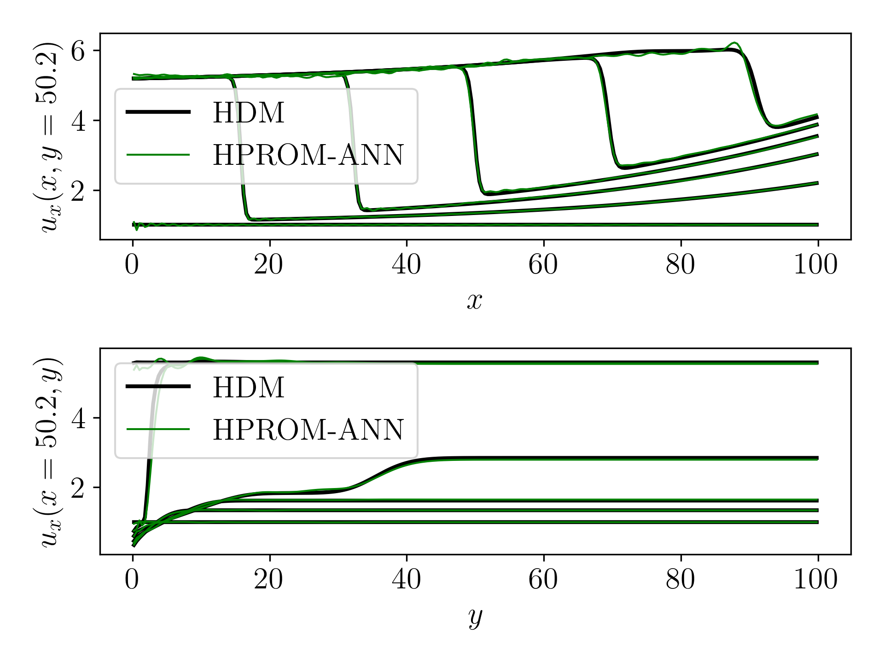
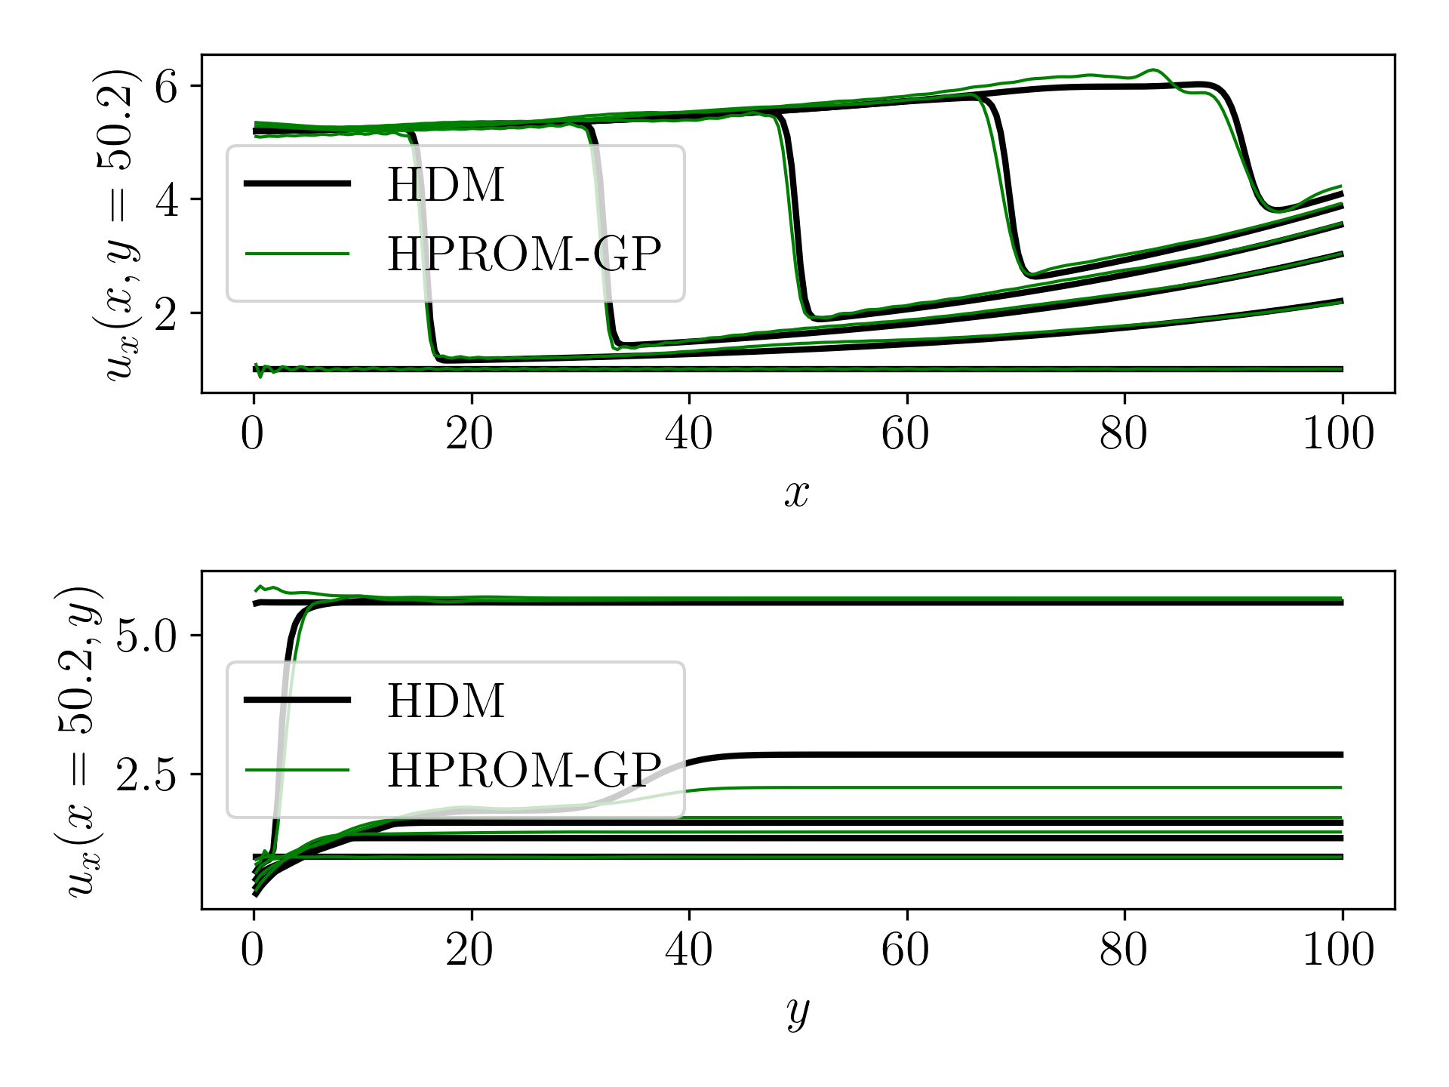
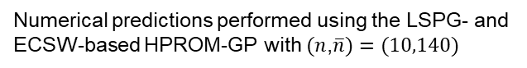
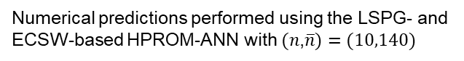
M1, $μ_{3}=\left(5.19, 0.026\right)$
RE= 1.51%
RE= 3.44%
Numerical predictions performed using the LSPG- and
ECSW-based HPROM-ANN with $(n$,$\overline{n})=(10,140)$
Numerical predictions performed using the LSPG- and
ECSW-based HPROM-GP with $(n$,$\overline{n})=(10,140)$

Slide 10
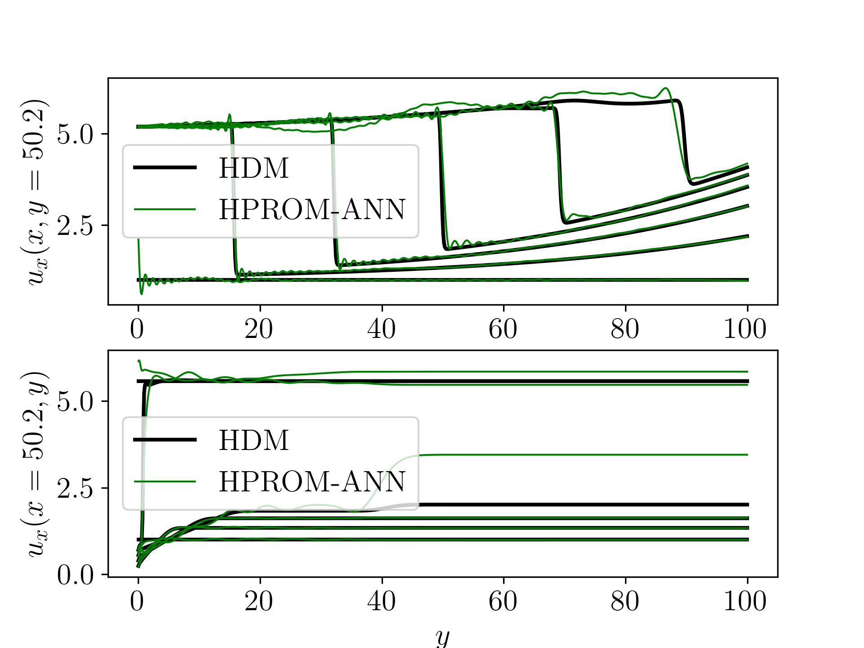
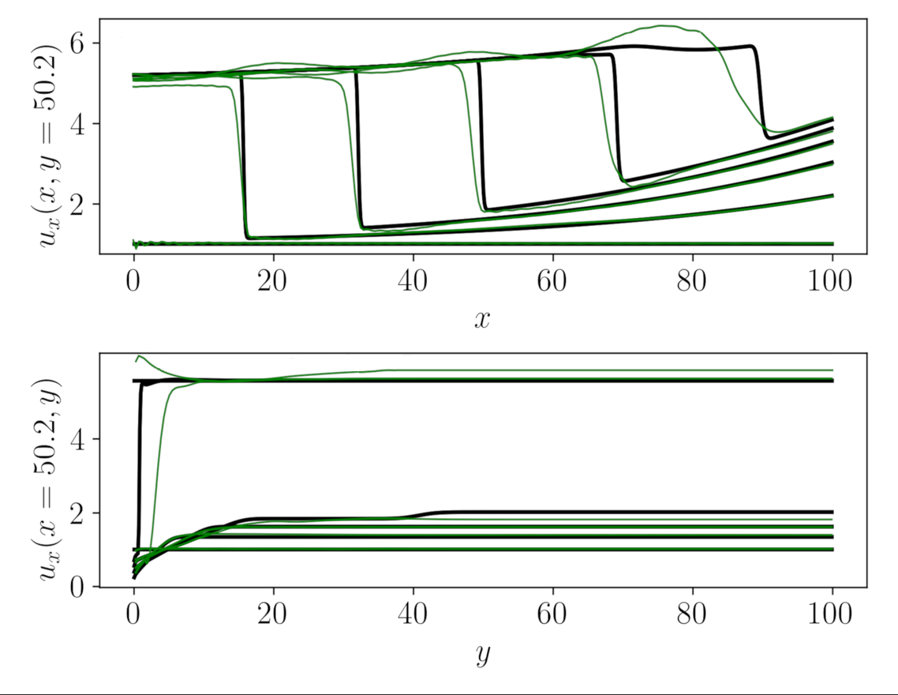
M2, $μ_{3}=\left(5.19, 0.026\right)$
RE=3.42%
RE=4.68%
Numerical predictions performed using the LSPG- and
ECSW-based HPROM-ANN with $(n$,$\overline{n})=(10,140)$
Numerical predictions performed using the LSPG- and
ECSW-based HPROM-GP with $(n$,$\overline{n})=(10,140)$

Slide 11
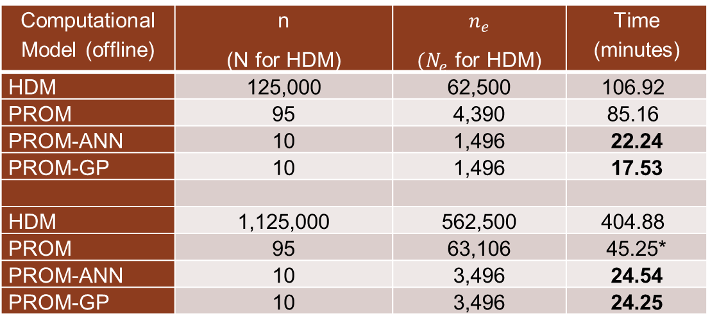
Offline performance (wall clock time)
Computational Model (offline) | n (N for HDM) | $$n_{e}$$ $(N_{e}$ for HDM) | Time (minutes)
HDM | 125,000 | 62,500 | 106.92
PROM | 95 | 4,390 | 85.16
PROM-ANN | 10 | 1,496 | 22.24
PROM-GP | 10 | 1,496 | 17.53
HDM | 1,125,000 | 562,500 | 404.88
PROM | 95 | 63,106 | 45.25*
PROM-ANN | 10 | 3,496 | 24.54
PROM-GP | 10 | 3,496 | 24.25
Mesh
M1
Mesh
M2
Table: Model parameters and offline performance results for both meshes
*Domain decomposition was used for M2

Slide 12
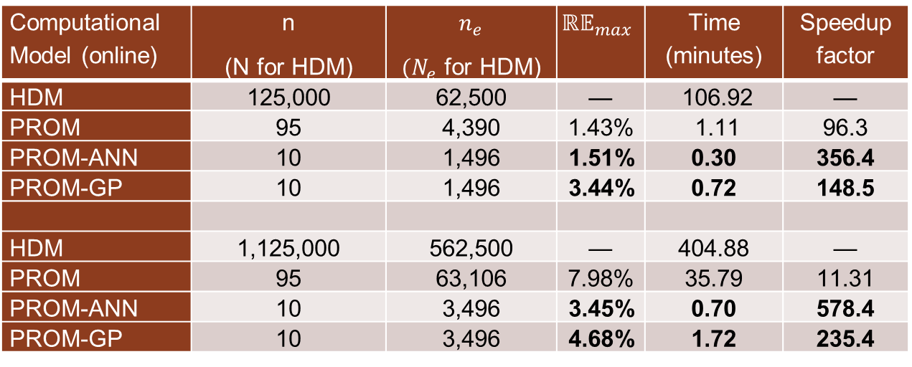
Online performance (wall clock time)
Computational Model (online) | n (N for HDM) | $$n_{e}$$ $(N_{e}$ for HDM) | $$ℝ𝔼_{max}$$ | Time (minutes) | Speedup factor
HDM | 125,000 | 62,500 | — | 106.92 | —
PROM | 95 | 4,390 | 1.43% | 1.11 | 96.3
PROM-ANN | 10 | 1,496 | 1.51% | 0.30 | 356.4
PROM-GP | 10 | 1,496 | 3.44% | 0.72 | 148.5
HDM | 1,125,000 | 562,500 | — | 404.88 | —
PROM | 95 | 63,106 | 7.98% | 35.79 | 11.31
PROM-ANN | 10 | 3,496 | 3.45% | 0.70 | 578.4
PROM-GP | 10 | 3,496 | 4.68% | 1.72 | 235.4
Mesh
M1
Mesh
M2
Table: Model parameters and online performance results for both meshes

Slide 13
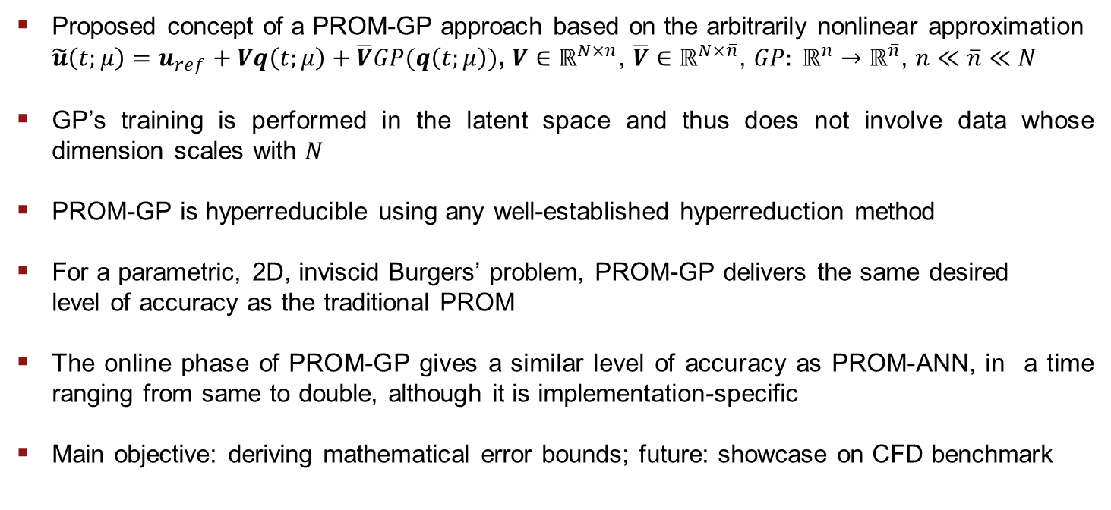
Conclusion & Future work
Proposed concept of a PROM-GP approach based on the arbitrarily nonlinear approximation
$\tilde{u}\left(t;μ\right)=u_{ref}+Vq\left(t;μ\right)+\overline{V}GP(q\left(t;μ\right))$, $V∈ℝ^{N×n}$, $\overline{V}∈ℝ^{N×\overline{n}}$, ${GP: ℝ}^{n}→ℝ^{\overline{n}}$, $n≪\overline{n}≪N$
GP’s training is performed in the latent space and thus does not involve data whose dimension scales with $N$
PROM-GP is hyperreducible using any well-established hyperreduction method
For a parametric, 2D, inviscid Burgers’ problem, PROM-GP delivers the same desired
level of accuracy as the traditional PROM
The online phase of PROM-GP gives a similar level of accuracy as PROM-ANN, in a time ranging from same to double, although it is implementation-specific
Main objective: deriving mathematical error bounds; future: showcase on CFD benchmark

Slide 14
Back-up slides

Slide 15
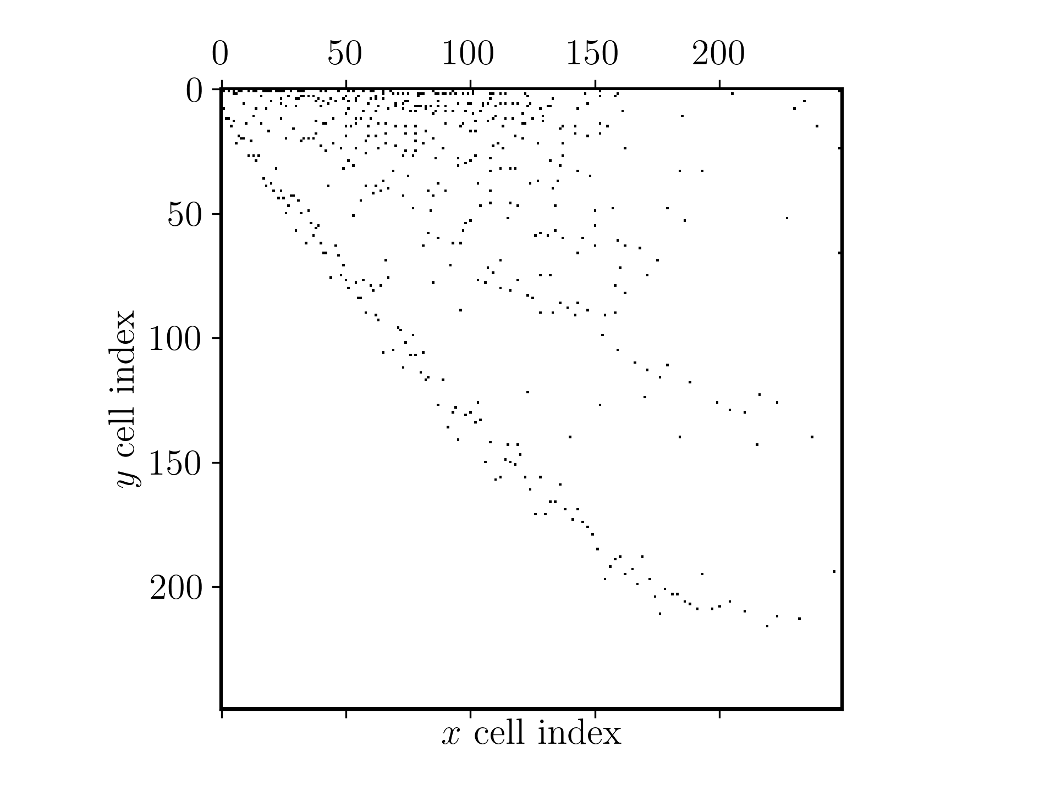
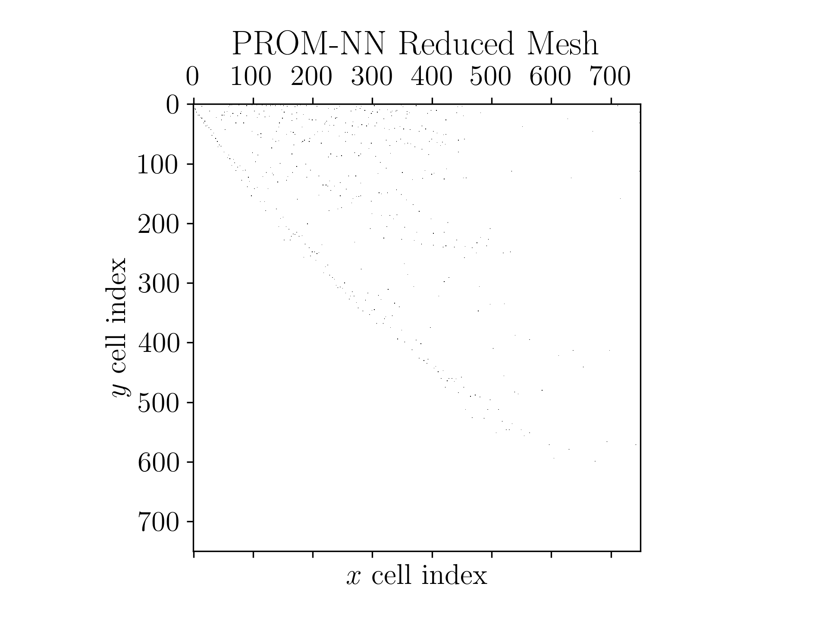
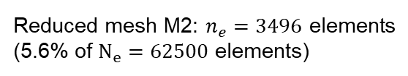
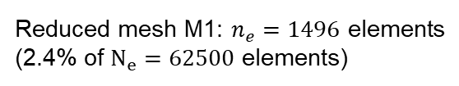
Hyperreduction using ECSW
ECSW training:
at only one of the sample parameter points – namely, (4.25, 0.0225)
at every 10-th solution snapshot
Reduced mesh M1: $n_{e}=1496$ elements (2.4% of $N_{e}=62500$ elements)
Reduced mesh M2: $n_{e}=3496$ elements (5.6% of $N_{e}=62500$ elements)

Slide 16
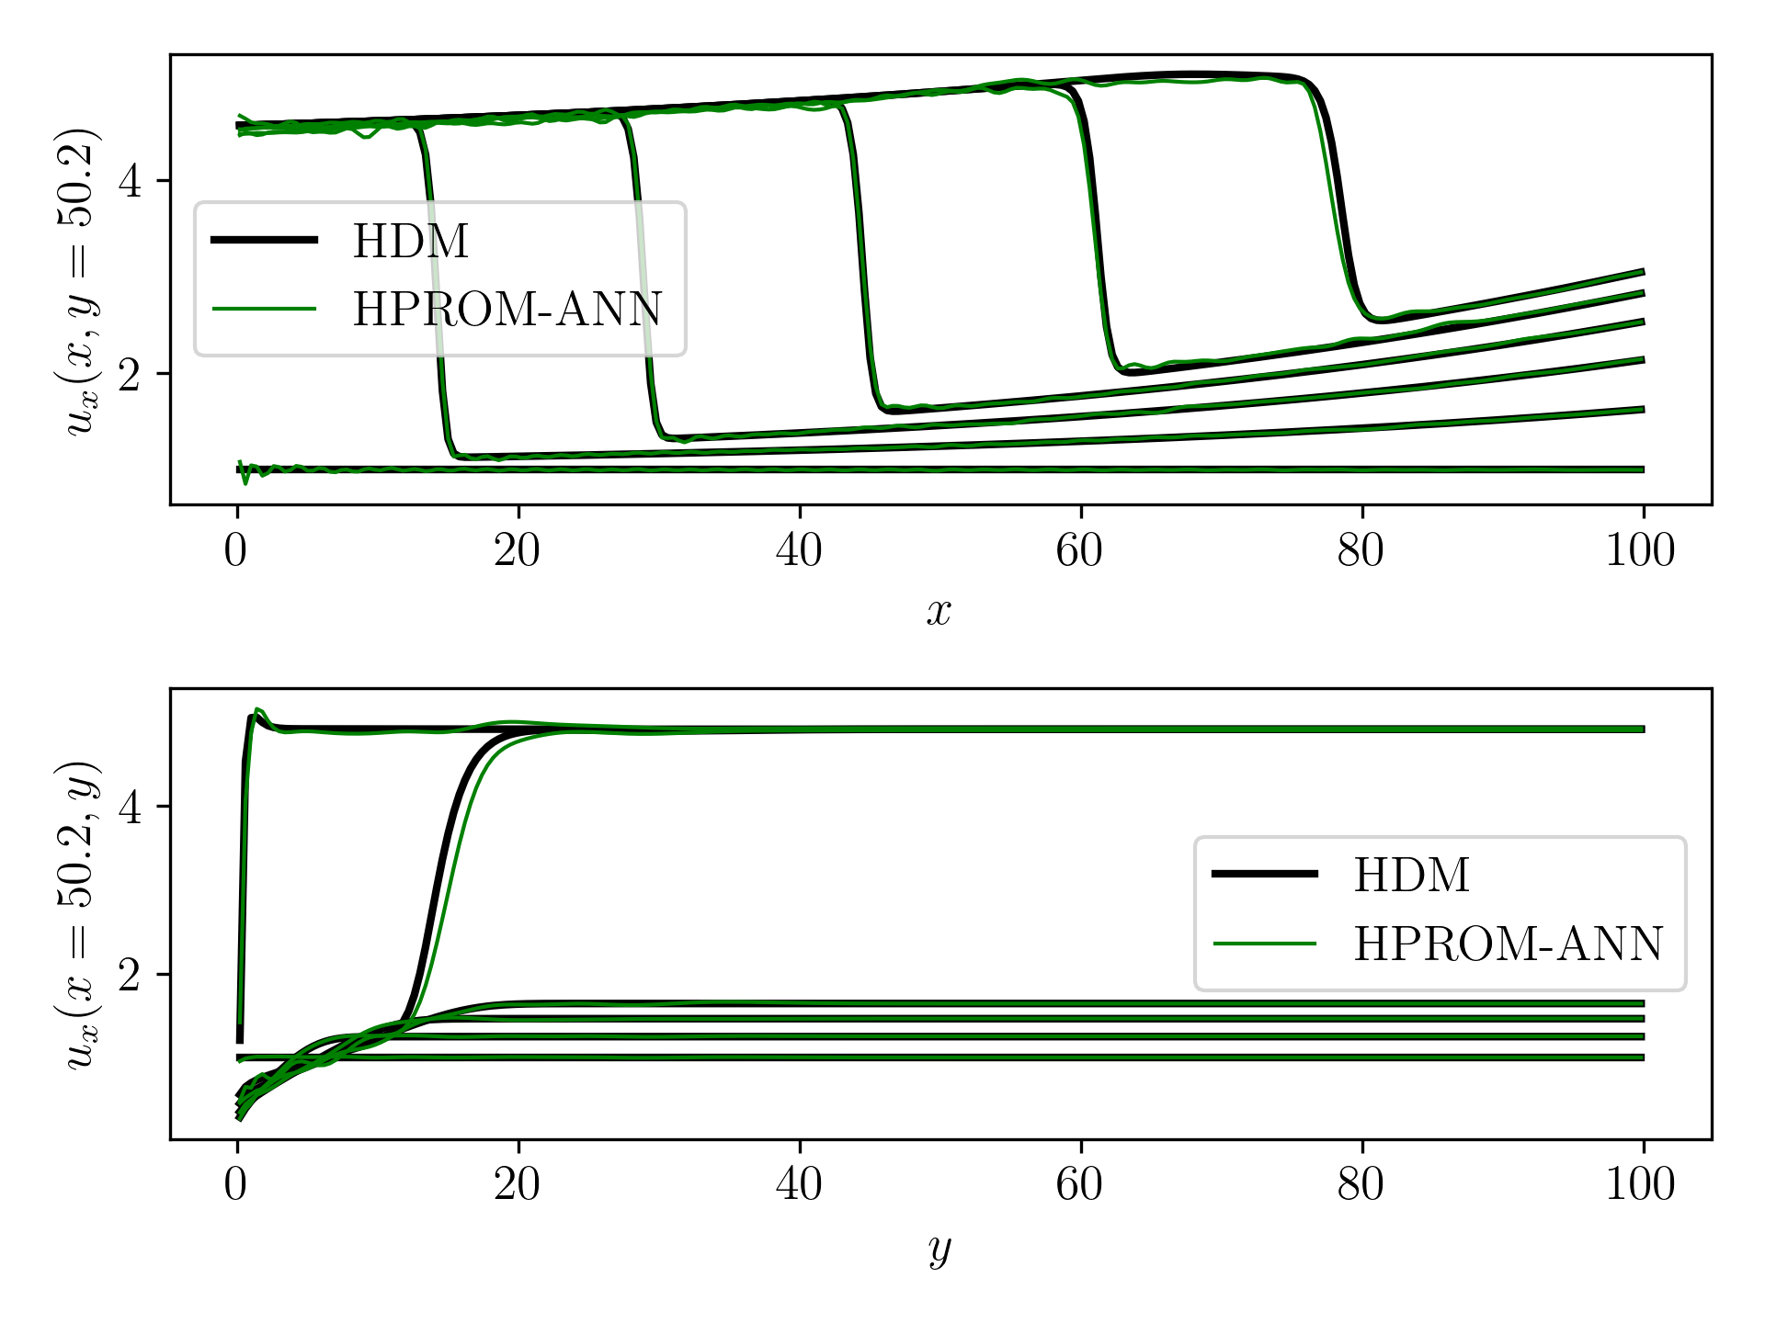
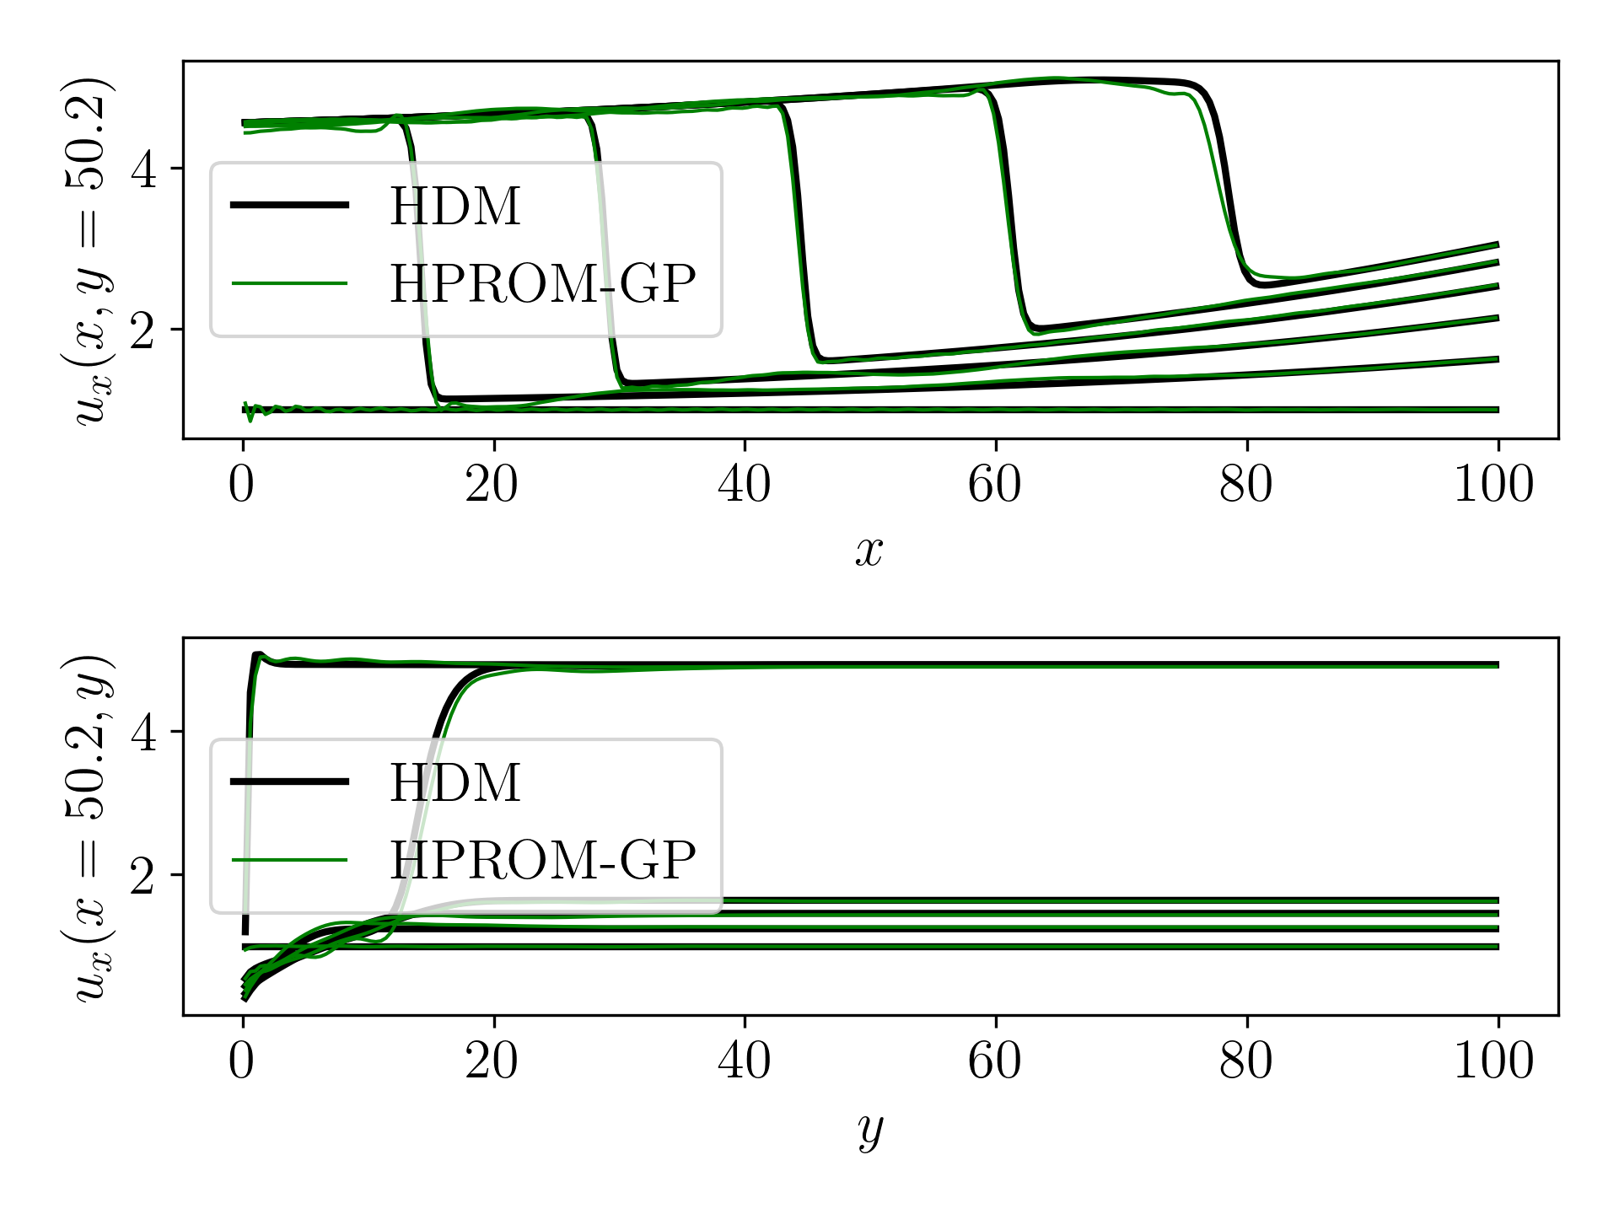
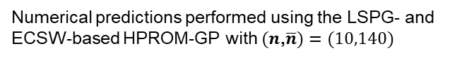
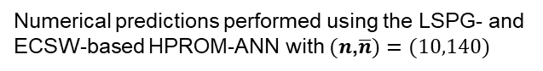
M1, $μ_{1}=\left(4.56, 0.019\right)$
RE= 1.01%
RE= 2.08%
Numerical predictions performed using the LSPG- and
ECSW-based HPROM-ANN with $(n$,$\overline{n})=(10,140)$
Numerical predictions performed using the LSPG- and
ECSW-based HPROM-GP with $(n$,$\overline{n})=(10,140)$

Slide 17
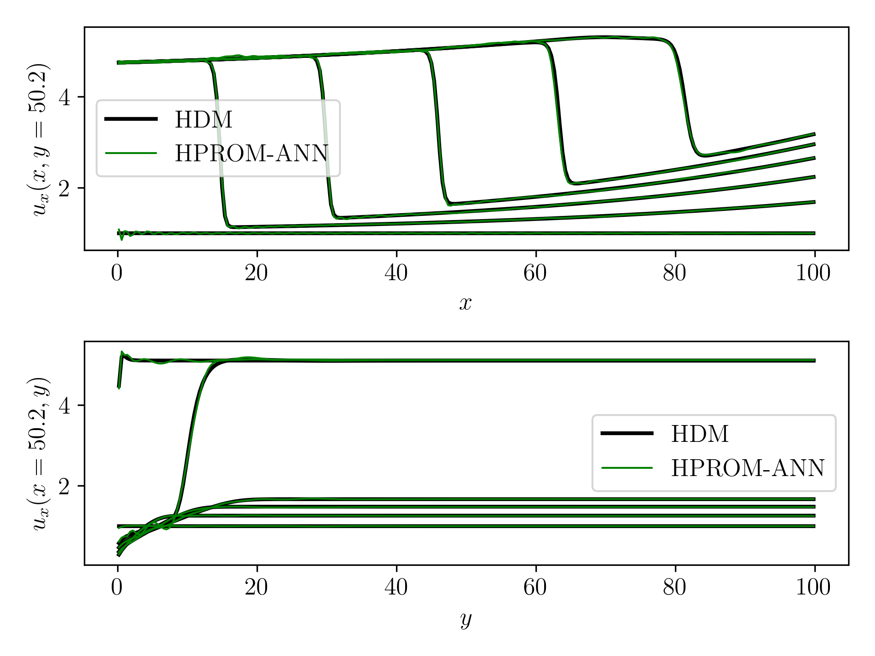
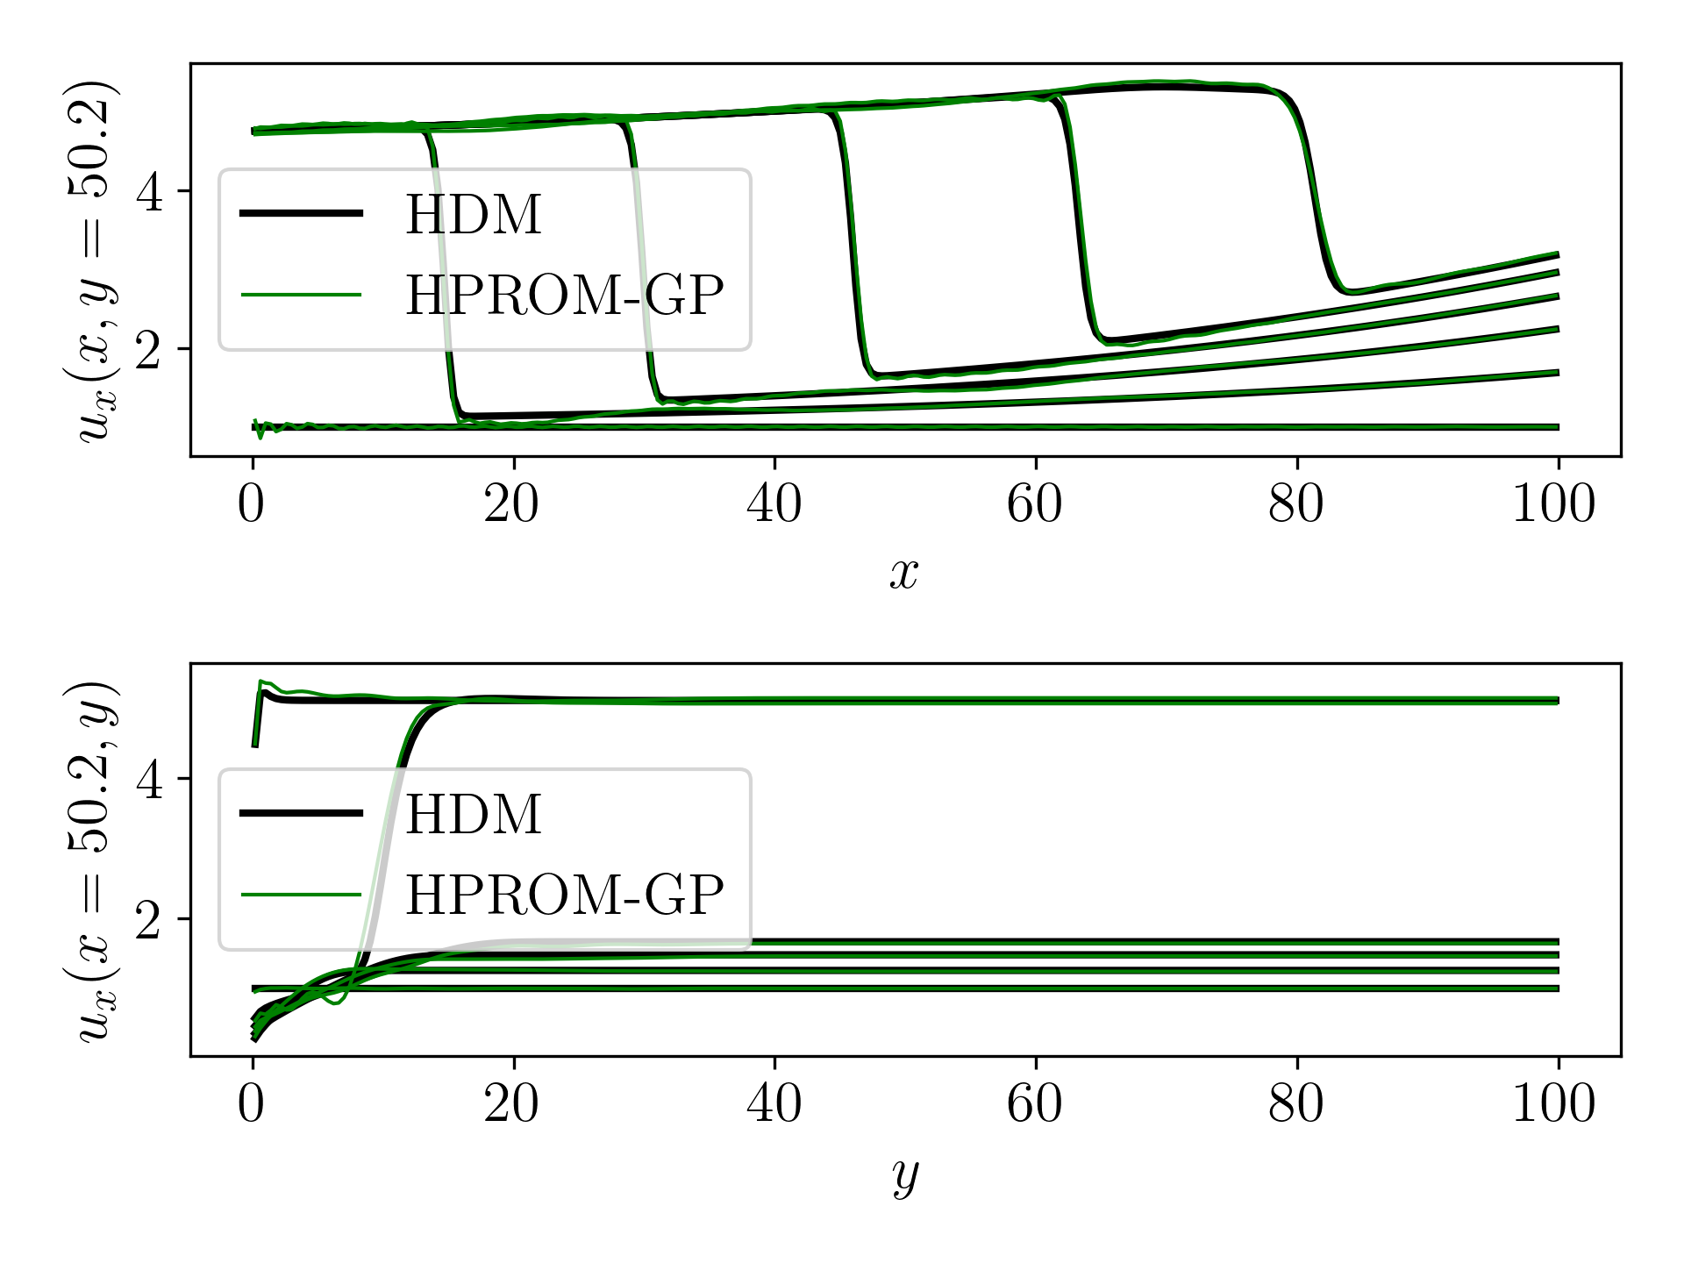
M1, $μ_{2}=\left(4.75, 0.02\right)$
RE= 1.21%
RE= 1.62%
Numerical predictions performed using the LSPG- and
ECSW-based HPROM-ANN with $(n$,$\overline{n})=(10,140)$
Numerical predictions performed using the LSPG- and
ECSW-based HPROM-GP with $(n$,$\overline{n})=(10,140)$

Slide 18
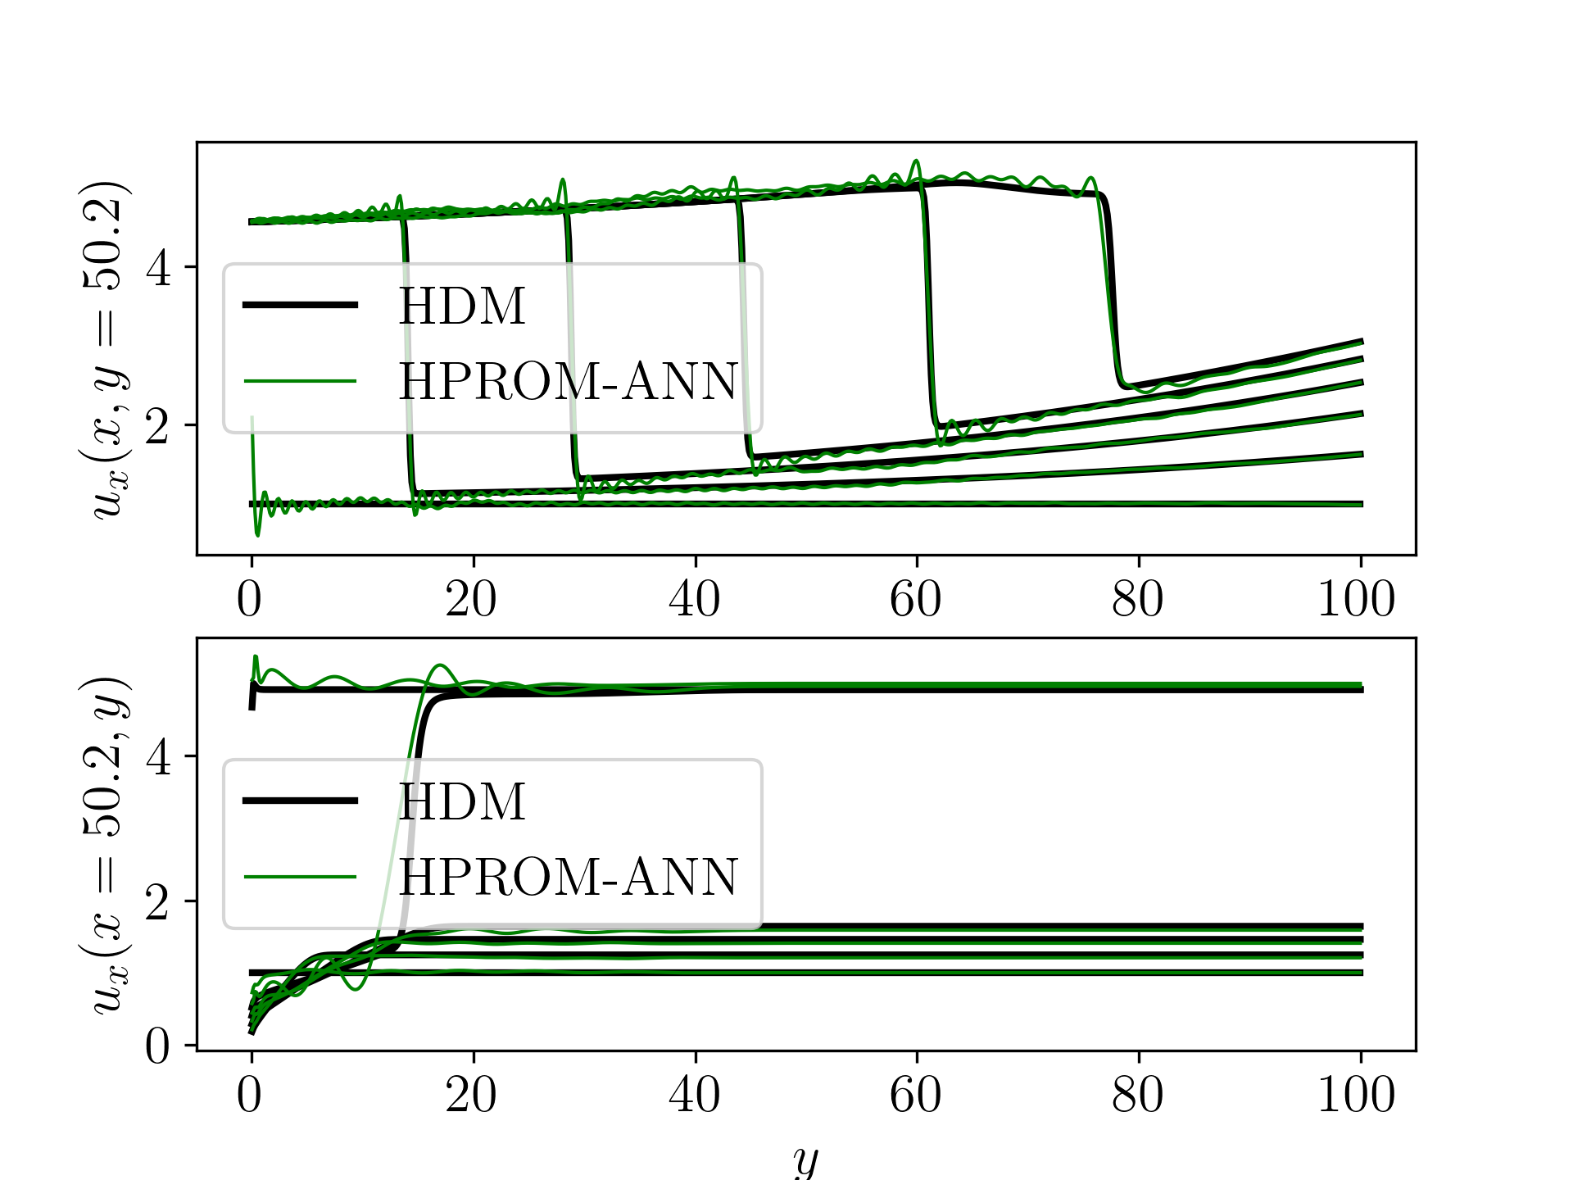
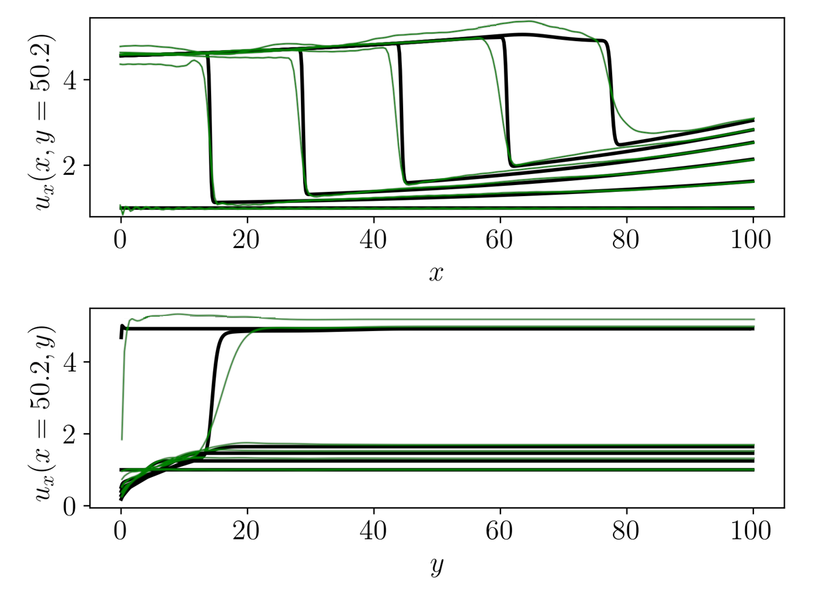
M2, $μ_{1}=\left(4.56, 0.019\right)$
RE=3.45%
RE=4.10%
Numerical predictions performed using the LSPG- and
ECSW-based HPROM-ANN with $(n$,$\overline{n})=(10,140)$
Numerical predictions performed using the LSPG- and
ECSW-based HPROM-GP with $(n$,$\overline{n})=(10,140)$

Slide 19
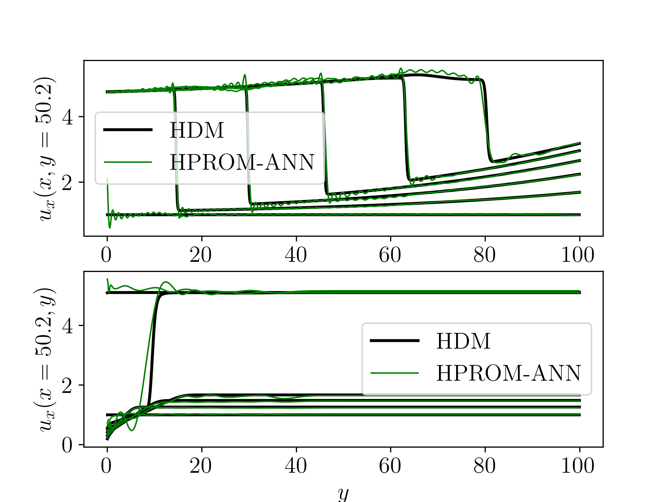
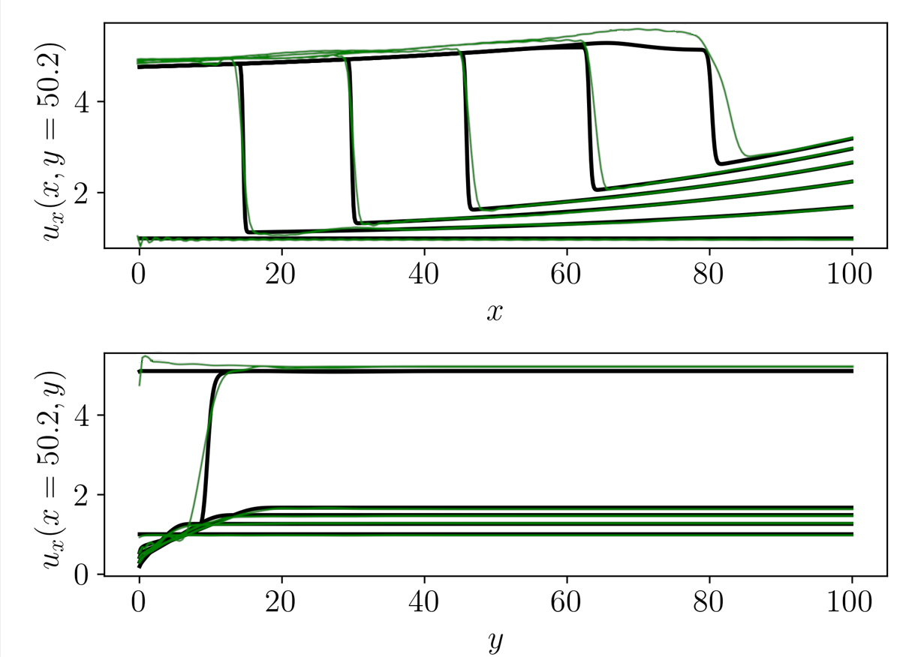
M2, $μ_{2}=\left(4.75, 0.02\right)$
RE=3.28%
RE=4.47%
Numerical predictions performed using the LSPG- and
ECSW-based HPROM-ANN with $(n$,$\overline{n})=(10,140)$
Numerical predictions performed using the LSPG- and
ECSW-based HPROM-GP with $(n$,$\overline{n})=(10,140)$

Slide 20
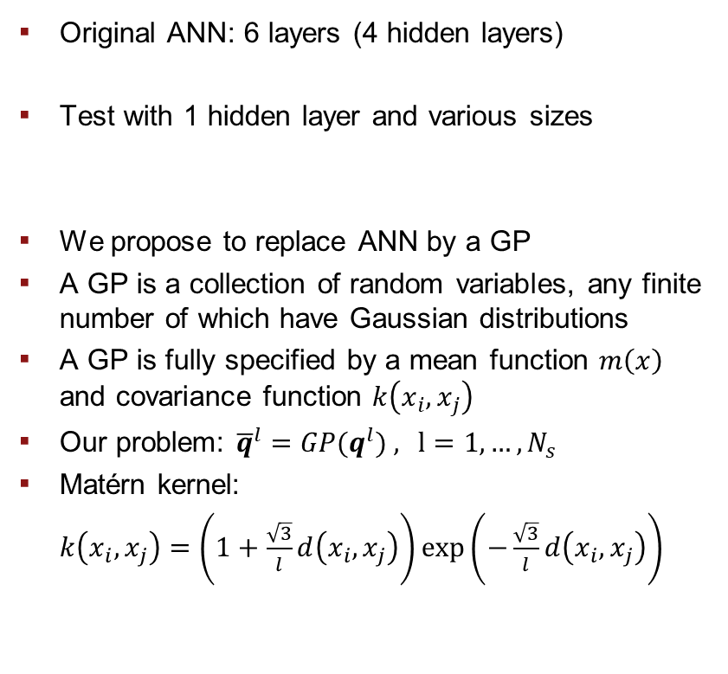
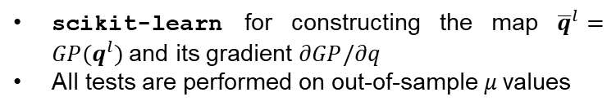
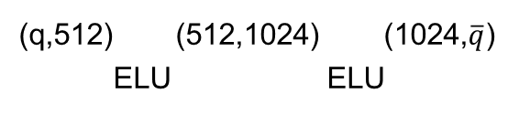
Alternative approach: gaussian processes
Original ANN: 6 layers (4 hidden layers)
Test with 1 hidden layer and various sizes
We propose to replace ANN by a GP
A GP is a collection of random variables, any finite number of which have Gaussian distributions
A GP is fully specified by a mean function $m\left(x\right)$ and covariance function $k\left(x_{i},x_{j}\right)$
Our problem: ${\overline{q}}^{l}={GP(q^{l})}^{ }$, $l=1, …, N_{s}$
Matérn kernel:
$k\left(x_{i},x_{j}\right)=\left(1+\frac{\sqrt{3}}{l}d\left(x_{i},x_{j}\right)\right)\exp\left(−\frac{\sqrt{3}}{l}d\left(x_{i},x_{j}\right)\right)$
ANN Type | Elapsed Time (s) | RE
4HL, original | 16.01 | 0.79%
1HL,(32,64) | 15.63 | 8.38%
1HL,(256,256) | 19.65 | 2.19%
1HL,(512,512) | 20.19 | 1.55%
1HL,(512,1024) | 22.80 | 1.74%
Barnett et al. 2023, JCP
(q,512) (512,1024) (1024,$\overline{q}$)
ELU ELU
scikit-learn for constructing the map ${\overline{q}}^{l}={GP(q^{l})}^{ }$and its gradient $∂GP/∂q$
All tests are performed on out-of-sample $μ$values

